Slide 1
Welcome! Class of 2027 to Rams Family Acceptance Night
Notes:
Tony-Welcome

Slide 2
Our Mission
At Shawsheen Valley Technical High School, it is our mission to provide a positive learning experience in a safe educational environment that encourages all students to reach their full potential, emphasizes the value of a strong work ethic, and prepares them for adult life in a competitive world.
This Photo by Unknown author is licensed under CC BY-SA.
Notes:
Jess

Slide 3
Preparing Students for an Adult Life in a Competitive World
Academic Courses
Vocational Programs (including Exploratory)
Student Attendance
Co-operative Employment
Student Expectations & Employability Skills
MCAS
SkillsUSA
Student Activities & Athletics
Notes:
Jess – will update – core values?

Slide 4
Schedule and Important Dates:
Over the summer:
Student course assignments
Start of school-year information
Family Aspen credentials
New Student Orientation: Tuesday, September 5, 2023
Academic schedule walk-through
Mobile devices issued
Technology overview session
Student credentials for all school platforms
Student expectations
Orientation Leader Activities
All Students Report: Wednesday, September 6, 2023
Academic week for freshmen
1st exploratory cycle: September 11-15, 2023
Daily Schedule
7:00am-7:25am | Student entry begins at 7am Breakfast in cafeteria until 7:25am
7:30am-7:47am | Students report to HR by 7:30am
7:47am-2:04pm | 8 period school day 5 student lunches
2:04pm | Student Dismissal
3:15pm | Late Bus Leaves (Mon-Thurs)
5:30pm | Late Bus Leaves (Mon-Fri)
Notes:
Jess

Slide 5
Expectations of the Exploratory Experience
14 Different Program Cycles
Each Cycle is Week-long
All programs have enrollment capacities.
A student’s performance is essential in obtaining their top selection.
Students will select their shop at the beginning of the 4th Quarter.
Notes:
Dave

Slide 6
The Freshmen Year Academic Experience
Director of Academic Programs—Danica Johnston
All students take:
English 9
Geometry or Algebra I
US History I
Civic Literacy
Digital Literacy
Biology
PE/Health
**English Learner Education Program**
Notes:
Danica – will speak to ELL program
Levels 1-5
Homework at all levels
90 days to learn 180 days of curriculum
Other opportunities – CE, Seal of Biliteracy

Slide 7
Educational Technology and Digital Learning Annamaria Schrimpf – Director of Educational Technology/Digital Learning
STUDENTS INFO
Digital Literacy for 9th Grade Students
1:1 laptop program
Week 1—ACADEMIC week all students bring laptop
Week 2—SHOP week teacher's discretion
Tech Insurance Fee
Chargers and pens can be purchased at School Store
Online resources
Office 365
Single Sign On for most school resources—ASPEN, Office 365, Destiny, Naviance, Schoology, Classlink
PARENTS INFO
Help Desk link on website
ASPEN issues, etc
Blackboard Parent Notification
Back to School contact verification registration
Notes:
Annamaria

Slide 8
Guidance Counseling & Health Services
Jim Carlson – Director of Guidance and Health Services
504/Title IX/Civil Rights Coordinator
Nurses’ office:
Nina Brophy - RN, BSN
Elizabeth West - RN, BA
Kathy Gravlin - LPN
Guidance Counselors:
Angela Caira/Counselor TBD – Grade 9
Greg Harrison – Advanced Manufacturing, Auto Body, Automotive, Dental Assisting, Medical Lab Assisting and Metal Fabrication
Terry Henry – Business Tech/Marketing, Drafting, Graphic Arts, Health Assisting, Masonry
Kelly McFadden – Carpentry, Electrical, HVAC, Plumbing
Amanda Samaha – Cosmetology, Culinary Arts/Hospitality, DVC, Electronics/Engineering, ISSN, Programming and Web Development
Notes:
Jim

Slide 9
Support Services (Special Education) Jeff Albert – Director of Support Services
Support Services has a Team of 25 Professional Staff
The Support Services Team supports all students who are on an Individual Educational Program (IEP) with their appropriate needs and services to access Shawsheen Programing
The Support Services Staff is comprised of 15 Teachers, one Speech Language Pathologist, two School Psychologists, two School Adjustment Counselors, 5 Para-Professionals
In Addition to our Team, we also contract with a:
- Behavior Specialist - Occupational Therapist
- Physical Therapist - Assistive Tech Specialist
We Offer a full range of services that include;
- Consultation
- Co-teaching/support in the general education setting
- Direct instruction in small groups
- Related Services
Counseling and Mental Health Supports

Slide 10
Get involved with our Shawsheen Clubs Assistant Principal for Student Affairs—Kevin Caruso
Notes:
Kevin

Slide 11
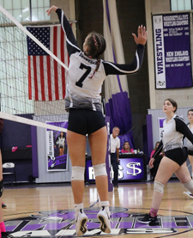
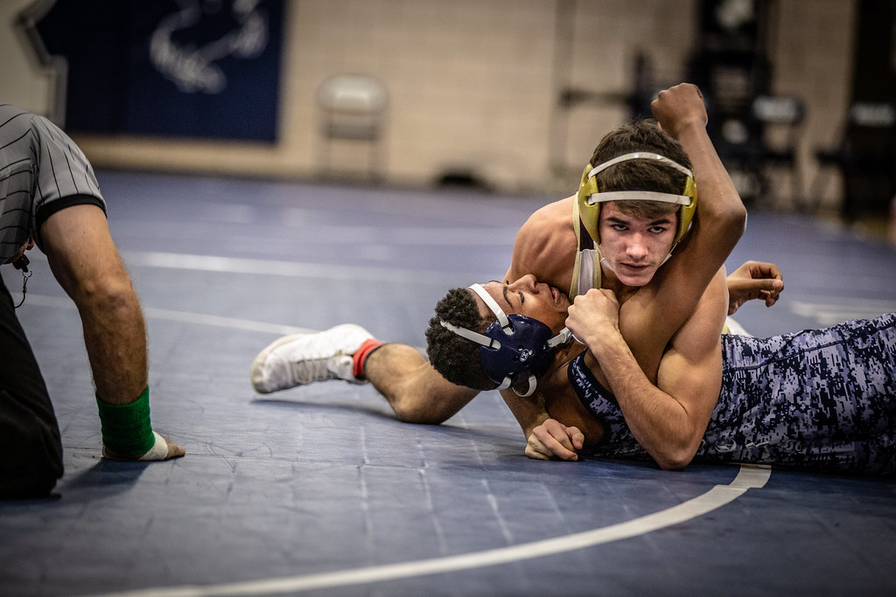
ATHLETICS AT SHAWSHEEN Director of Athletics—Al Costabile
T
.
Notes:
Al ?

Slide 12
Fall Sports Information
Fall Sports
Football (Varsity, JV and Freshman)
Football Cheering (Varsity and JV)
Boys Soccer (Varsity and JV)
Girls Soccer (Varsity and JV)
Cross Country
Volleyball (Varsity and JV)
Golf
Tryout Info
Football Cheer-Mon (6/5), Wed (6/7) & Fri (6/9) 5:00pm-8:00pm in Café
Football-Friday, August 18th
All Other Sports-Monday, August 21st
All Student-Athletes interested in participating in a sport, MUST register through FamilyID, have a current physical uploaded to their FamilyID account and complete concussion protocols prior to tryouts.
Please check the Shawsheen Tech Athletics webpage for more details including Registration Links, Sport Specific Tryout Information and Coaches Contact Information.
Questions
Al Costabile, Athletic Director - acostabile@shawtech.org
Jaime Lee, Athletics Administrative Assistant - jlee@shawtech.org

Slide 13
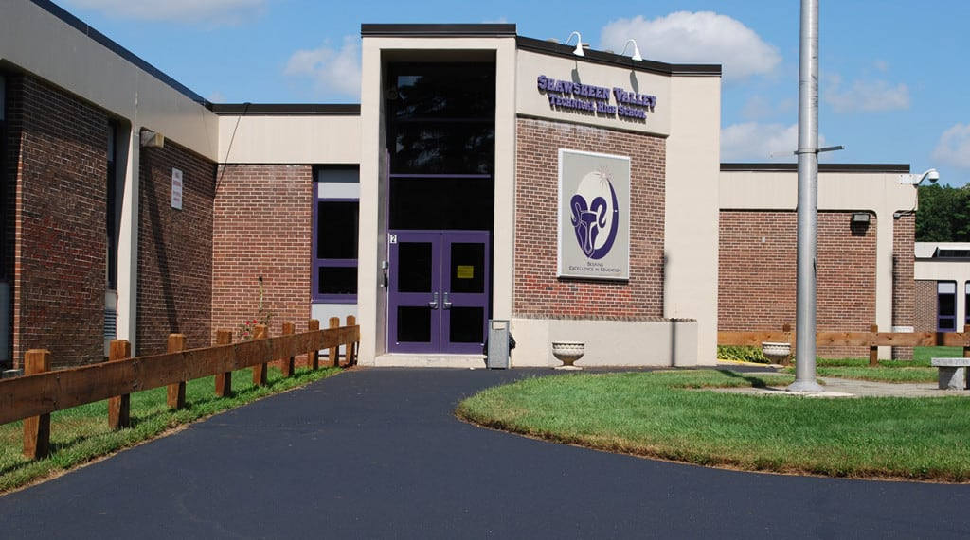
Student Panel Making the best of your Shawsheen freshman experience

Slide 14
Online Resources
WWW.SHAWSHEENTECH.ORG
SCHOOL-WIDE INFORMATION
@SHAWTECH_HS
SPORTS INFORMATION
@SHAWTECH_SPORTS

Slide 15
THANK YOU FOR COMING—ANY QUESTIONS?

